Slide 1
Azure Virtual Desktop
Optum Connect
Pranav Singh

Slide 2
Agenda
1
Development of AVD standard offering
2
AVD Environment Pre-Requisites Preparation
3
OC AVD Standard Architecture
4
The Star Team
5
Collaboration with Customer Stakeholder
6
Planning Network Connectivity and Architecture
7
Deployment of AVD Infrastructure using TFE Pipeline Services
8
RACI
9
DaaS & Progression

Slide 3
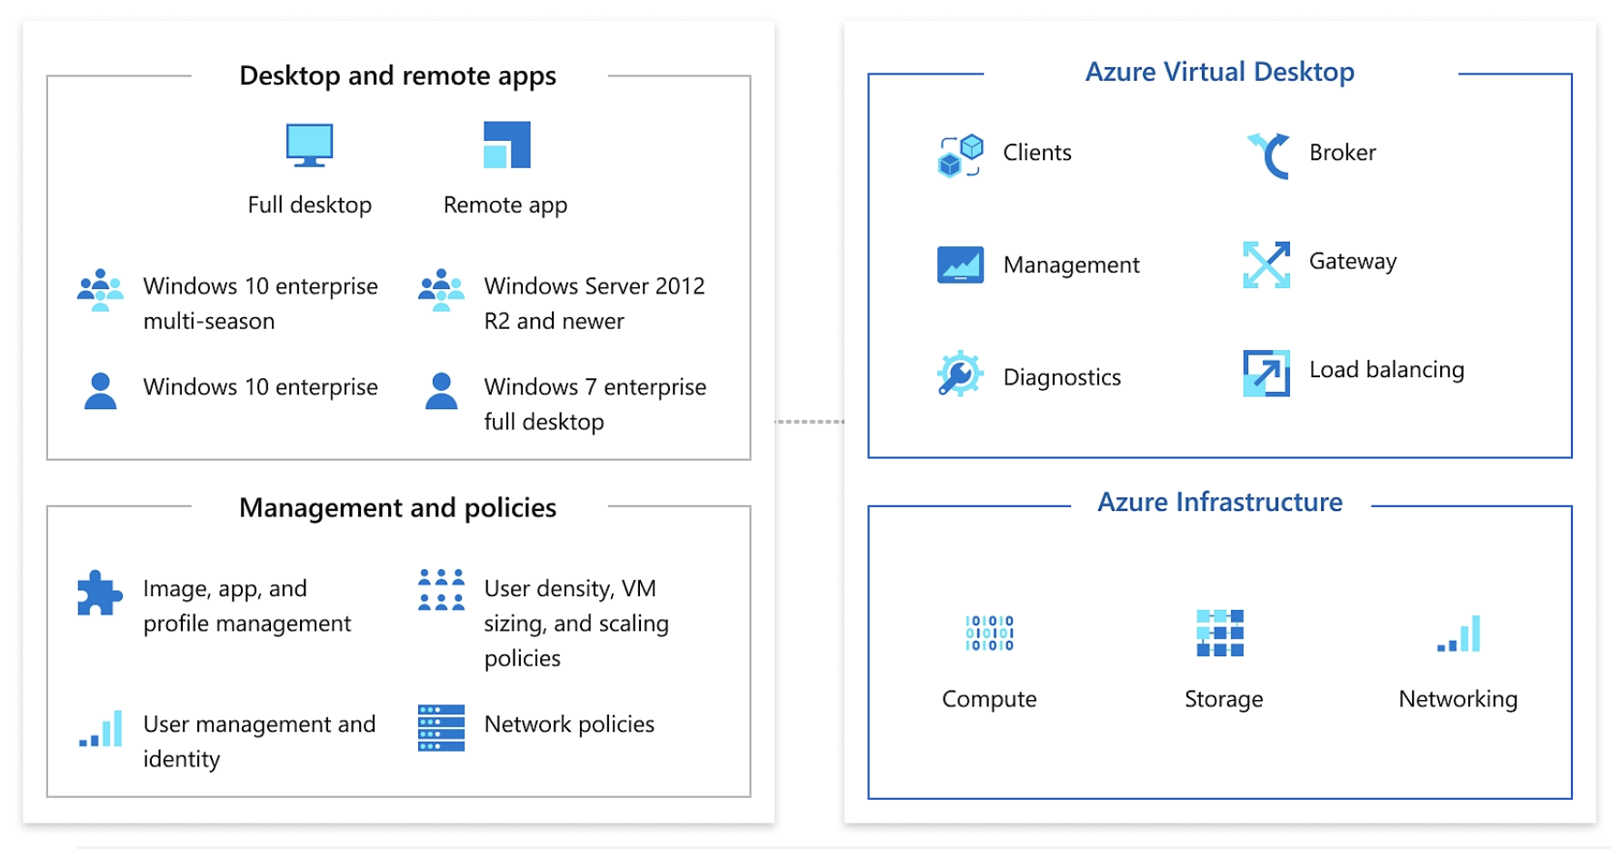

Development of AVD standard offering
Defining what AVD will look like by detailing:
Generalized Architecture
Operating system
Network Connectivity & firewall
Virtual machine sizes
License Requirements
Published Apps
Security and Compliance
Monitoring

Slide 4






AVD Environment Pre-Requisites Preparation
Initiating the discovery call
Onboarding to Optum Connect CSP tenant
Build out initial services:
Umbrella Policies
Prisma Policy management
Microsoft Defender for Cloud (Security Center)
PowerBI Cost management and reporting
AOBO activity logging

Slide 5
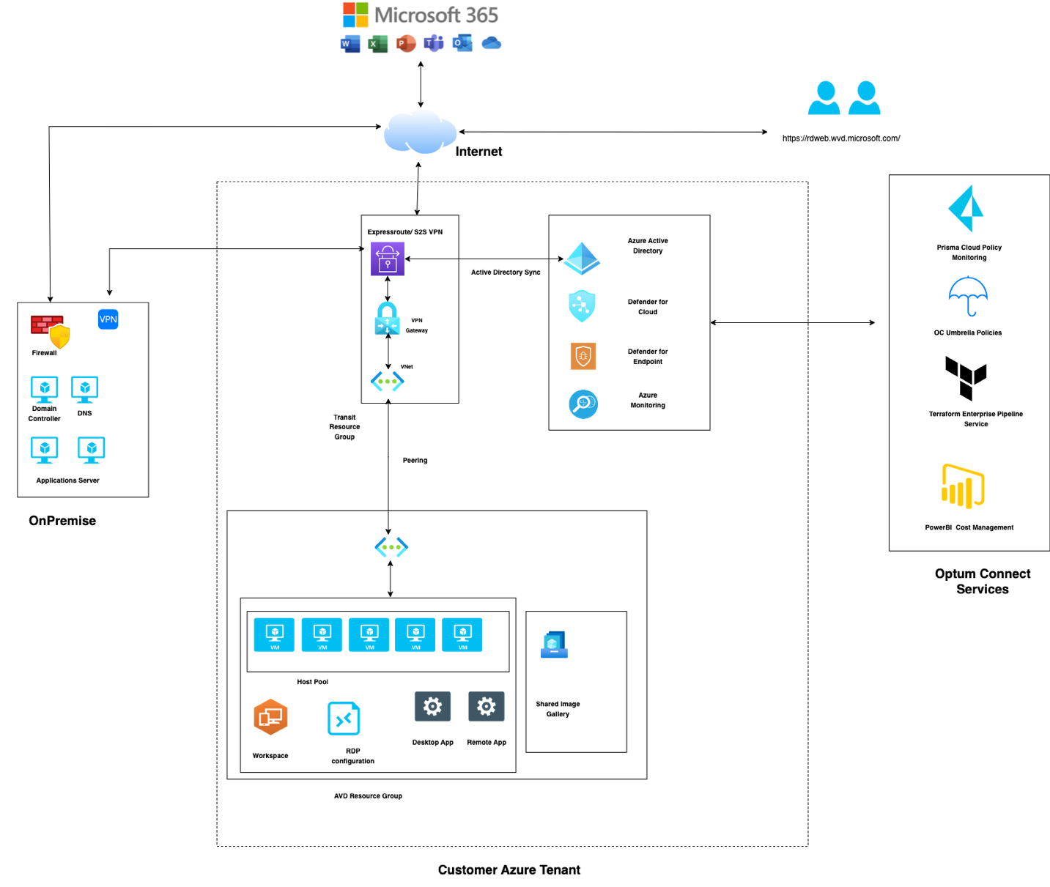
OC AVD Standard Architecture

Slide 6
The Star Team
Customer Technical Teams
OC Desktop Engineering
OC Cloud
OC Architecture & Solutions
OC Workplaces Services

Slide 7

Collaboration with Customer Stakeholder
Designing the solution and configuration requires understanding the customers current IT environment. This involves initiating the discussion with the stakeholders who manages:
Network
Active Directory
Endpoint Security
Patching and Configuration management
Group Policy
Security – Endpoint and Network
AVD onboarding Questionnaire Document to capture the micro details using AVD onboarding Questionnaire Document:

Slide 8




Planning Network Connectivity and Architecture
Solution is designed and developed by prioritizing user profile, which includes:
Identifying type of user (General/Developer etc.)
Number of users
Identifying origin of the user traffic
Applications which user would be accessing
User Profile management
Other factors includes:
Cost effectiveness
Platform and network Security
Scaling and high availability

Slide 9
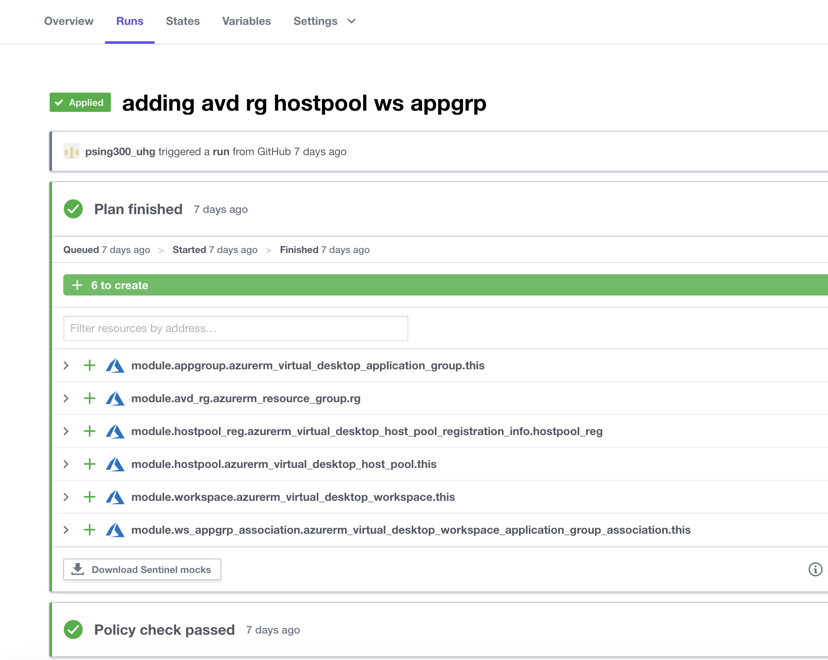




Deployment of AVD Infrastructure using TFE Pipeline Services
Automations to deploy:
Pre-AVD resources ( Site-to-Site VPN/Express Route, VNet etc.)
AVD services (Host pool, Application Groups, Workspaces etc.)
AVD Host pools
Scaling of Host Pools
Deployment of MDFC for Platform Security
Upgradation of Infrastructure and AVD Resources
Modules
TFE
AVD Pool

Slide 10
RACI
Assessment Phase | Task Name | Workplace Services | Platform Engineering | OC Cloud Engineering | OC Cloud Operations | Network | Security | Architecture Team | Stakeholders
 | Validation of VDI infrastructure on prem | I | R,A |  |  |  |  | C | I
 | Validation of No of VDI machine and their sizes | I | R,A |  |  |  |  | C | I
 | Validation of No. of Users | R,A | C |  |  |  |  | C | I
 | Validation of licensing & application | I | R,A |  |  |  |  | C | I
 | Categorization of User type (light/medium/heavy/power users) | R,A | C |  |  |  |  | C | I
 | Develop AVD Enterprise Scale Terraform IaC Modules and the required Framework | I |  | R,A |  |  |  | C | I
 | GPO and AD infrastructure Validation | I | R,A |  |  |  |  | C | I
 | Golden Image Validation | R,A | C |  | I |  |  | C | I
 | Software & Patching Cycle | C,I | R,A |  |  |  |  | C | I
Preparation Phase | Create the client AVD architecture diagram |  | C | C |  |  |  | R,A | I
 | On-boarding the customer to Azure CSP subscription |  |  | R,A,C |  |  |  |  | I
 | NCAP (Subscription, SPN etc creation) |  |  | R,A,C |  |  |  |  | I
 | Onboarding of customer TFE org setup |  |  | R,A,C |  |  |  |  | I
 | Deployment of Cloud Security & Posture Management Resources |  |  | C | R,A |  | C |  | I
 | Configuration of Network connectivity with AD DC Server ( Express Route/VPN) |  |  | C | R,A | C |  |  | I
 | Setup of ADFS and Firewall |  | R,A |  |  | C | C |  | I
Deployment Phase | Deploy AVD Landing zone |  |  | C | R,A |  |  |  | I
 | Deploy AVD Modules using the TFE pipeline services |  |  | C | R,A |  |  |  | I
 | Implement AVD scaling plan |  | C | C | R,A |  |  |  | I
 | Deploy File share and Profile Retention using Fslogix |  | C | C | R,A |  |  |  | I
 | Pilot user access assignment on AVD | I | C | C | R,A |  |  |  | I
 | Setup Security & Performance Monitoring |  | C | C | R,A |  |  |  | I
 | Setup BCDR Plan (including backup of Azure File share) |  |  | C | R,A |  |  |  | I
 | Configure GPO specific to AVD | I | R,A |  |  |  | C |  | I
 | Deployment of Software and application | I | R,A |  |  |  | C |  | I
Operations Phase | Access Management & Creating and Publishing Application Groups |  | R,A |  | C |  | C |  | I
 | End User VDI Support & Collaboration Services support | R,A | C |  | C |  |  |  | I
 | Software Management, Patching & Upgrades | C | R,A |  | C |  | C |  | I
 | Monitoring of AVD Infra resources |  | C |  | R,A |  |  |  | I
 | Preparation of Golden Image and Testing | C | R,A | C | C |  | C |  | I
 | Develop Terraform Modules/Scripts for future enhancements and Resolving Bugfixes |  |  | R,A,C |  |  |  |  | I
 | Implement infrastructure Changes & upgrades managed via IAC pipeline |  |  | C | R,A |  |  |  | I

Slide 11
DaaS – Lifecycle management of AVD Deployment
Onboarding – Enablement of AVD Services including connectivity to on-premise, host pools, platform security and autoscaling
Desktop Engineering & Management – Development of Golden Image packed with the pre-installed software and configuration
Performance Monitoring and System Tracking – Monitoring, alerting and reporting system events and tracking
Security Incident & Event Management – Monitoring and corelating security incidents and events from multiple sources

Slide 12

Progression
Phase 1
Phase 2
Phase 3
Design & Develop
Operate
Enhance
AVD standard offering
TFE Workspace Designer
User Experience and Performance Tracking
Use case-based architecture and deployment strategy
Profile Management
Architecture
RACI Matrix
DaaS
Configuration Management
Golden Image
AVD onboarding questionnaire
SNOW Catalog
AVD TF Code
SIEM
Monitoring framework

Slide 13
Q&A

